Slide 1

Ahsanullah University of Science and Technology
Dept. of Electrical and Electronic Engineering
Undergraduate Thesis
A Comprehensive Analysis of Lung Cancer Detection Using Machine learning and Deep learning Approach

Slide 2





Supervised By
Dr. Umma Hany
Associate Professor
EEE,AUST
Thesis Conducted by
Nusraat Tahmina Nafe Abdullah
160205091 160205092 160205095 160205103
Undergraduate Students of
4th year 2nd semester
Dept of EEE,AUST

Slide 3

Introduction
Lung cancer is cancer that starts in the lungs. When a person has lung cancer, they have abnormal cells that cluster together to form a tumor.
Two main type of lung cancer
Small cell
Non-Small Cell
Small Cell Carcinoma
Combined Small Cell Carcinoma
Adenocarcino-ma
Squamous Cell Carcinoma
Large Cell Carcinoma

Slide 4
Motivation
From January 2015 to December 2017, 5,887 people with lung cancer were admitted to the hospital.
Lung was the leading site of cancers in men.24.7% men were admitted with lung cancer and 5.2% women.
77.2% of patients did not receive any kind of cancer treatment before attending NICRH
One-third of cancer patients in
Bangladesh are admitted to hospital.
Lung & Bronchus Cancer in US | Male | Female
Estimated New Cases | 119,100 | 116,660
Estimated New Deaths | 69,410 | 62,470

Slide 5

Objective
To detect malignant growth from
Computed Tomography (CT) images.
To enhance low-quality images into higher quality for machine learning.
To classify the lung tumor cancer using
CNN.
To apply different types of machine learning algorithm.
To compare the accuracy between
different types of algorithm.

Slide 6

Dataset
Normal
Benign
Malignant

Slide 7










Work flow
Step
Step
Step
Step
1
2
3
4
Data collection
Image Processing
Machine Learning
Results & Comparison
Feature Extraction
2 sets of data used
Deep Learning
Data from The Cancer Imagining Archive
Data from Luna-16 grand challenge

Slide 8

1. Image Processing for Lung Tumour Detection 2. Image Processing for Processing a Dataset To Achieve Better Accuracy in Various Machine Learning and Deep Learning model.
Image Processing

Slide 9
Implementation of Image Processing Techniques to Detect Lung Tumour Region

Slide 10

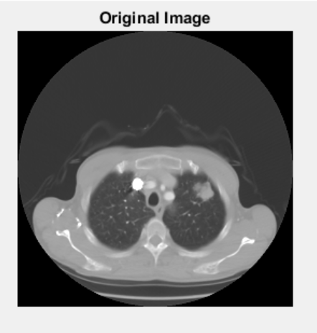
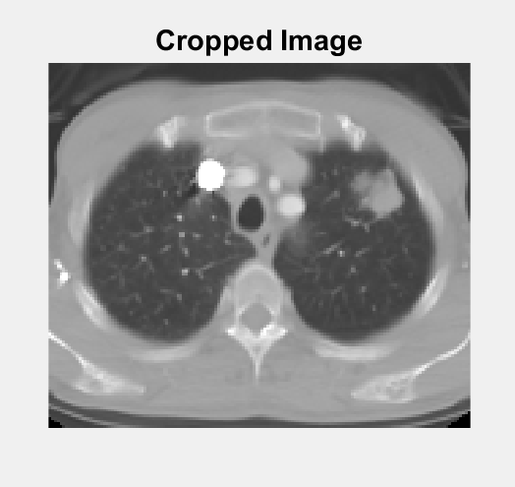
Image Pre-processing
Original Image
Resized Image

Slide 11

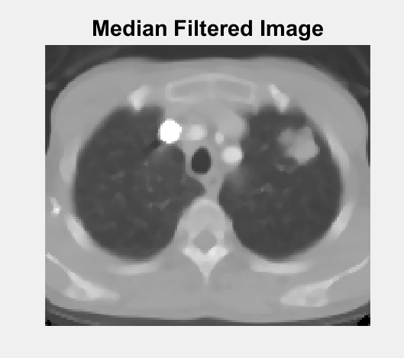
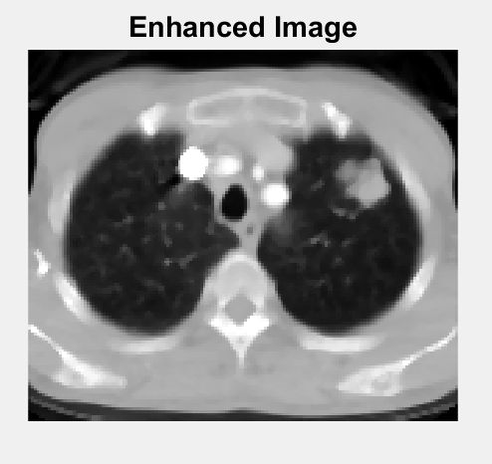
Image Smoothing and Enhancement
Image Smoothing
Image Enhancement

Slide 12

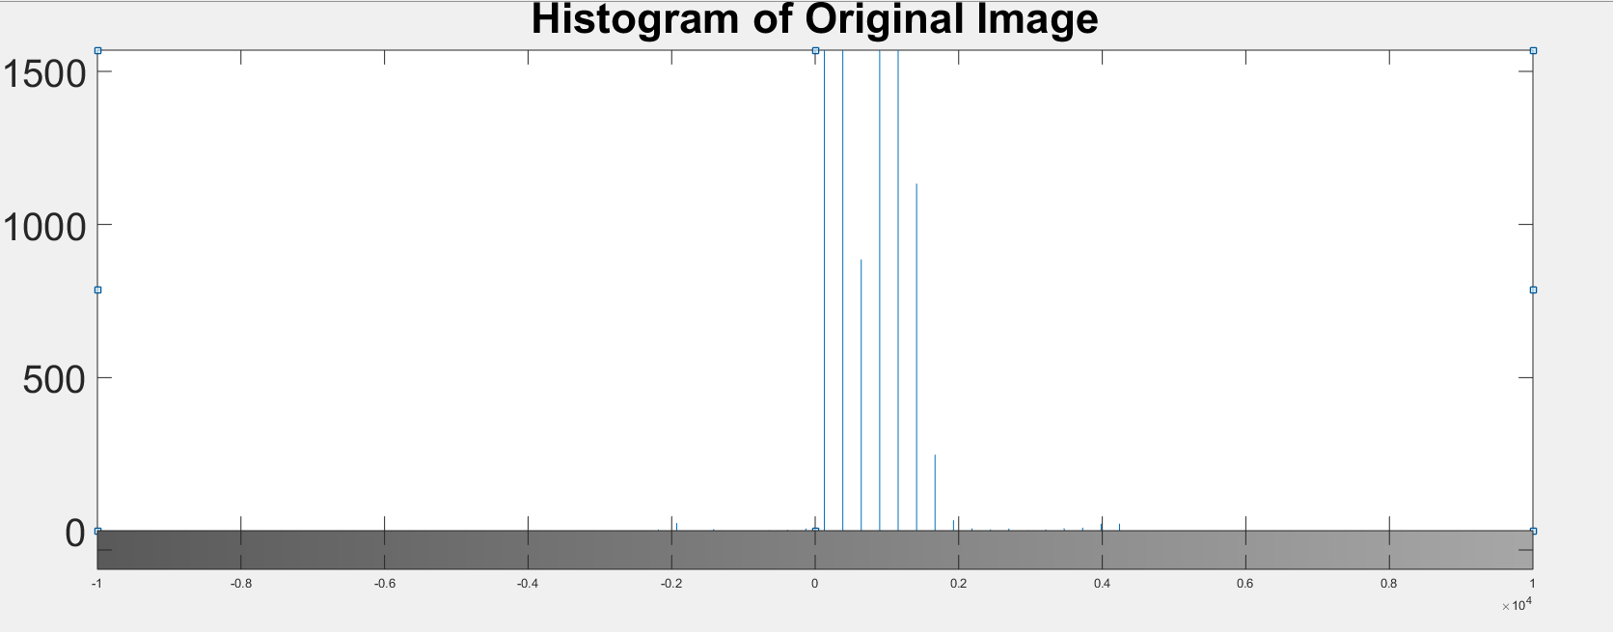
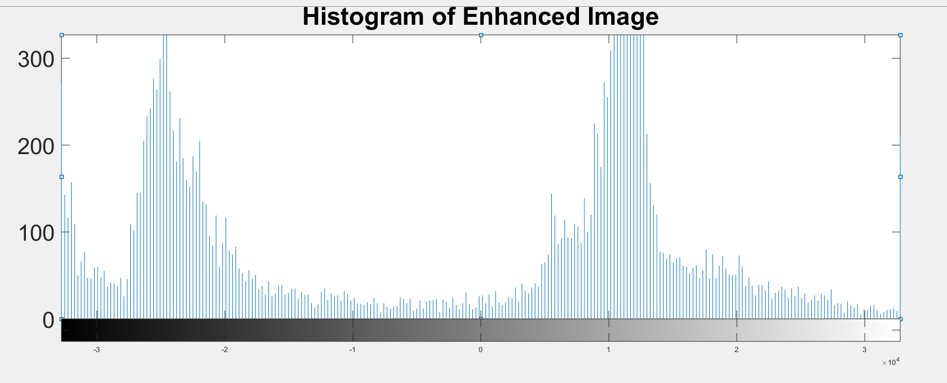
Histogram of Original and Enhanced Image
Histogram Plot of Original Image
Histogram Plot of Enhanced Image

Slide 13

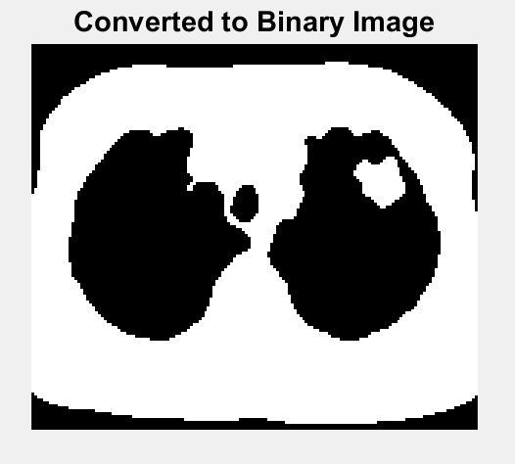
Image Segmentation
Otsu’s Method for Thresholding and Converted in Binary Image

Slide 14

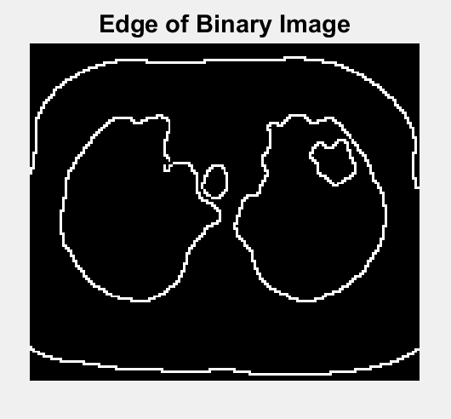
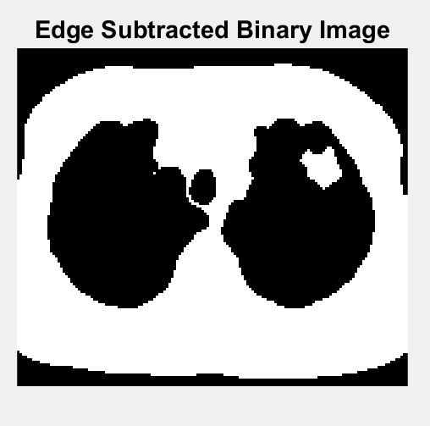
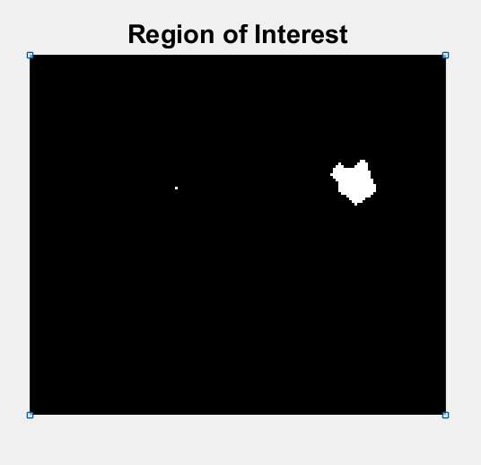
Edge Detection
Edge detection
Subtraction of Edges from Binary Image
Detected Tumour (ROI)

Slide 15

Feature Extraction
Area
Perimeter
Eccentricity
Compactness
Circularity

Slide 16
Implementation of Image Processing for Achieving Better Accuracy in Various Models

Slide 17

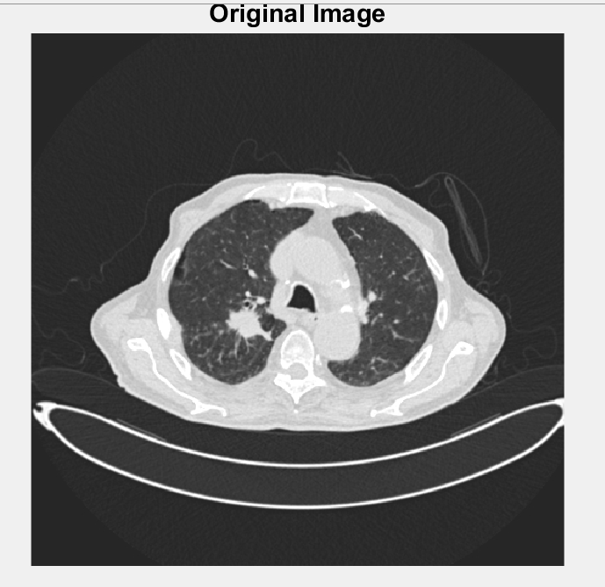
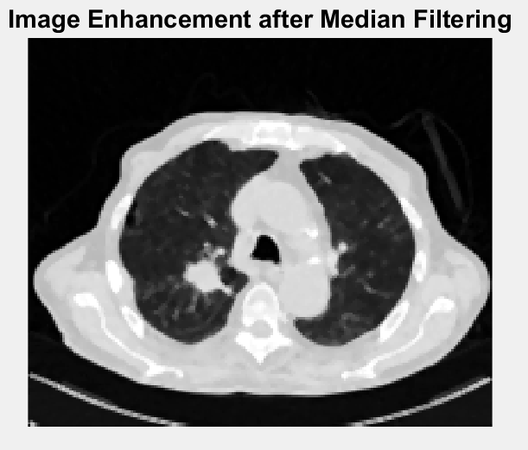
Image Pre-Processing
Image Enhancement After Median Filtering
Original Image

Slide 18
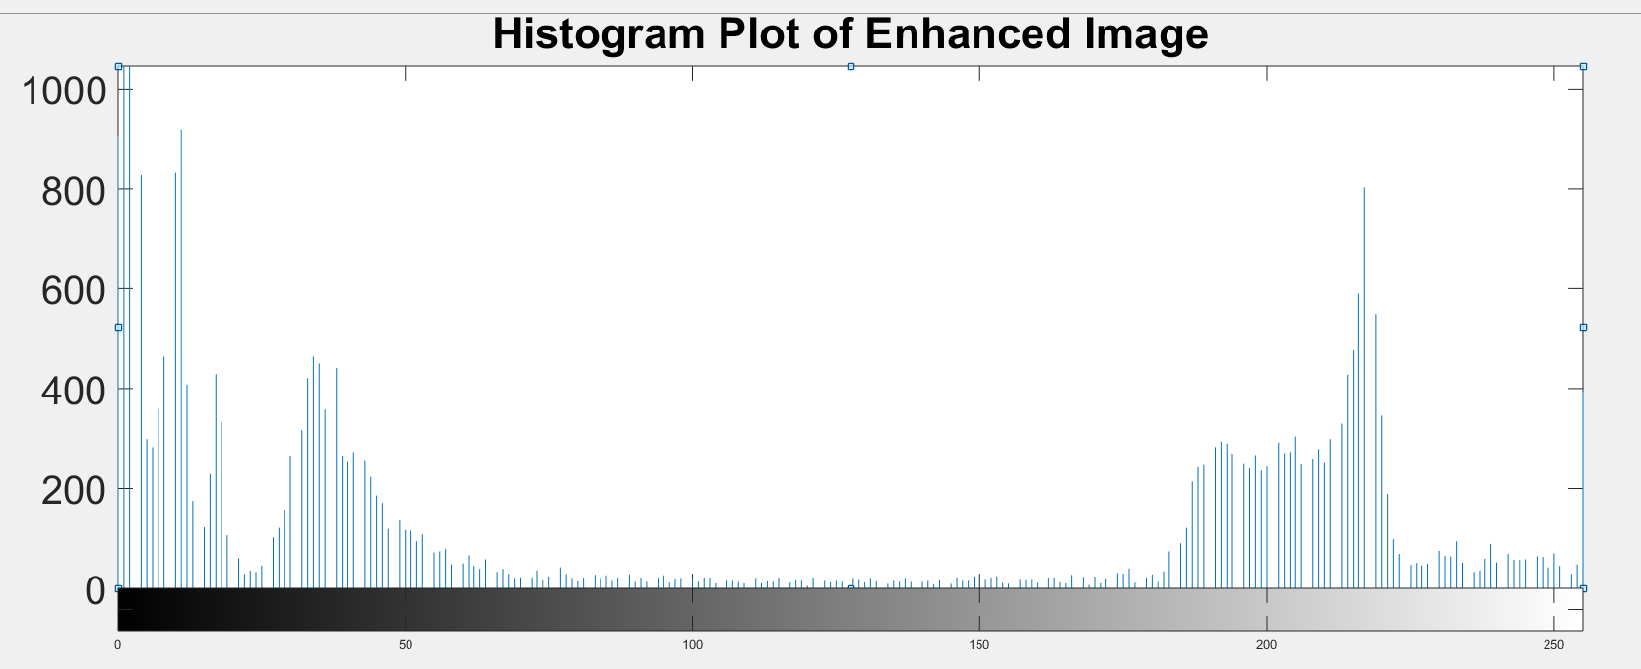
Histogram Plot of Enhanced After Median Filtering Image

Slide 19

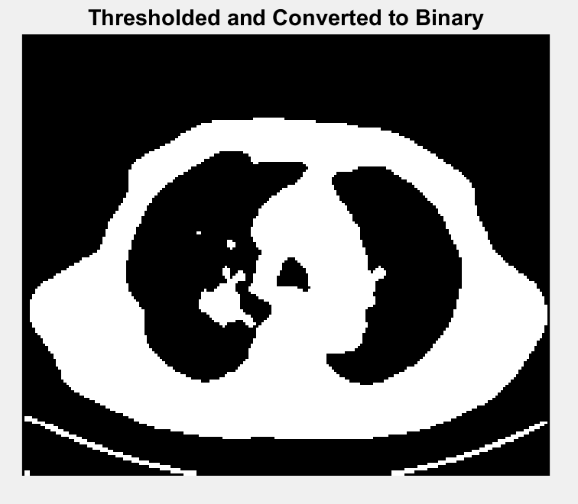

Image Segmentation
Processed Dataset
The image has been segmented based on a threshold level and then converted into binary image

Slide 20

Why Using Machine Learning in Health Care System

Slide 21
Machine learning Algorithms
Feature Extraction Method
SVM(Support vector machine)
Decision Tree
K-NN (K-Neighbors)
Naïve Bayes
Logistic Regression
Random Forest classifier
Transfer Learning – VGG 16

Slide 22

Accuracy Score comparison with Machine Learning approach
 | Accuracy Score for Processed Dataset | Accuracy Score for Without Processed Dataset | Accuracy Score for Vgg16 feature extraction
Decision Tree Classifier | 0.68 | 0.65 | 0.63
K-Nearest Neighbors Classifier | 0.70 | 0.65 | 0.72
Logistic Regression Classifier | 0.75 | 0.71 | 0.82
Naive Bayes Classifier | 0.58 | 0.60 | 0.69
Random Forest Classifier | 0.76 | 0.73 | 0.83
Support Vector Machine Classifier | 0.77 | 0.73 | 0.88

Slide 23
Classification Report
Accuracy in Classification
Precision
Recall
F1-score

Slide 24

BENIGN CASE CLASSIFICATION RESULTS
 | Processed Dataset |  |  | Without Processed Dataset |  |  | Vgg16 Feature Extraction Without Processed Dataset
 | precision | recall | f1-score | precision | recall | f1-score | precision | recall | f1-score
Decision Tree Classifier | 0.42 | 0.38 | 0.40 | 0.29 | 0.31 | 0.30 | 0.27 | 0.39 | 0.32
K-Nearest Neighbors Classifier | 0.18 | 0.35 | 0.24 | 0.22 | 0.28 | 0.25 | 0.15 | 0.22 | 0.18
Logistic Regression Classifier | 0.39 | 0.73 | 0.51 | 0.29 | 0.39 | 0.33 | 0.37 | 0.53 | 0.43
Naive Bayes Classifier | 0.21 | 0.42 | 0.28 | 0.07 | 0.14 | 0.10 | 0.17 | 0.03 | 0.05
Random Forest Classifier | 0.48 | 0.62 | 0.54 | 0.33 | 0.14 | 0.20 | 0.27 | 0.19 | 0.23
Support Vector Machine Classifier | 0.37 | 0.62 | 0.46 | 0.21 | 0.22 | 0.21 | 0.00 | 0.00 | 0.00

Slide 25

MALIGNANT CASE CLASSIFICATION RESULTS
 | Processed Dataset |  |  | Without Processed Dataset |  |  | Vgg16 Feature Extraction Without Processed Dataset
 | precision | recall | f1-score | precision | recall | f1-score | precision | recall | f1-score
Decision Tree Classifier | 0.73 | 0.74 | 0.73 | 0.75 | 0.77 | 0.76 | 0.80 | 0.81 | 0.80
K-Nearest Neighbors Classifier | 0.87 | 0.78 | 0.82 | 0.80 | 0.77 | 0.78 | 0.98 | 0.85 | 0.91
Logistic Regression Classifier | 0.95 | 0.74 | 0.83 | 0.84 | 0.88 | 0.86 | 0.95 | 0.99 | 0.97
Naive Bayes Classifier | 0.89 | 0.60 | 0.72 | 0.91 | 0.63 | 0.75 | 0.67 | 0.99 | 0.80
Random Forest Classifier | 0.83 | 0.81 | 0.82 | 0.78 | 0.86 | 0.82 | 0.94 | 0.99 | 0.97
Support Vector Machine Classifier | 0.90 | 0.83 | 0.87 | 0.87 | 0.89 | 0.88 | 0.98 | 1.00 | 0.99

Slide 26

NORMAL CASE CLASSIFICATION RESULTS
 | Processed Dataset |  |  | Without Processed Dataset |  |  | Vgg16 Feature Extraction Without Processed Dataset
 | precision | recall | f1-score | precision | recall | f1-score | precision | recall | f1-score
Decision Tree Classifier | 0.66 | 0.66 | 0.66 | 0.62 | 0.60 | 0.61 | 0.54 | 0.46 | 0.49
K-Nearest Neighbors Classifier | 0.69 | 0.67 | 0.68 | 0.61 | 0.60 | 0.60 | 0.65 | 0.68 | 0.66
Logistic Regression Classifier | 0.69 | 0.77 | 0.73 | 0.69 | 0.58 | 0.63 | 0.82 | 0.67 | 0.74
Naive Bayes Classifier | 0.48 | 0.60 | 0.53 | 0.59 | 0.68 | 0.63 | 0.79 | 0.47 | 0.59
Random Forest Classifier | 0.72 | 0.71 | 0.71 | 0.61 | 0.62 | 0.62 | 0.76 | 0.78 | 0.77
Support Vector Machine Classifier | 0.75 | 0.73 | 0.74 | 0.69 | 0.66 | 0.67 | 0.77 | 0.97 | 0.86

Slide 27

F1 Score Comparisons of Processed Dataset
On Processed Dataset
 | Logistic Regression Classifier | Random Forest Classifier | Support Vector Machine Classifier | CNN
BENIGN CASE | 0.51 | 0.54 | 0.46 | 0.29
MALIGNANT CASE | 0.83 | 0.82 | 0.87 | 0.91
NORMAL CASE | 0.73 | 0.71 | 0.74 | 0.70

Slide 28

F1 Score comparison for VGG16 Feature Extraction
 | Logistic Regression Classifier | Random Forest Classifier | Support Vector Machine Classifier | CNN
BENIGN CASE | 0.43 | 0.23 | 0.00 | 0.19
MALIGNANT CASE | 0.97 | 0.97 | 0.99 | 0.96
NORMAL CASE | 0.74 | 0.77 | 0.86 | 0.81

Slide 29

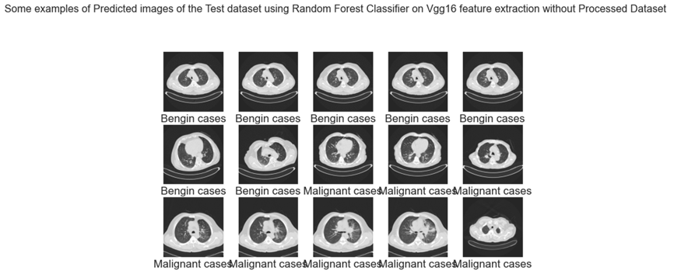
Some of the Predictions

Slide 30

Deep Learning
A Convolutional Neural Network (CNN) is a Deep Learning algorithm which can take in an input image, assign importance (learnable weights and biases) to various aspects/objects in the image and be able to differentiate one from the other.

Slide 31

Input Layer
(Sequential)
Convolution 2D,kernel(3*3)
Relu
Maxpooling
Pool size(2*2)
Dense Layer
(Flatten)
CNN Architecture
Output
(Softmax)

Slide 32

Deep learning Classification Results
 | CNN with Processed Dataset |  |  | CNN without Processed Dataset |  |  | Vgg16 feature Extraction without Processed Dataset
 | precision | recall | f1-score | precision | recall | f1-score | precision | recall | f1-score
BENIGN CASE CLASSIFICATION RESULTS | 0.21 | 0.46 | 0.29 | 0.39 | 0.31 | 0.34 | 0.29 | 0.14 | 0.19
MALIGNANT CASE CLASSIFICATION RESULTS | 0.94 | 0.88 | 0.91 | 0.76 | 0.92 | 0.83 | 0.96 | 0.96 | 0.96
NORMAL CASE CLASSIFICATION RESULTS | 0.76 | 0.64 | 0.70 | 0.69 | 0.53 | 0.60 | 0.76 | 0.87 | 0.81

Slide 33

Some Predictions of Deep Learning

Slide 34

Deep learning Approach Accuracy Table
Deep learning Classification Results
 | Training Loss | Validation Loss | Training Accuracy | Validation Accuracy | Accuracy Score
CNN with Processed Dataset | 2.5199e-04 | 0.1237 | 1.0000 | 0.9742 | 0.75
CNN without Processed Dataset | 4.6185e-04 | 0.0019 | 1.0000 | 1.0000 | 0.71
Vgg16 feature extraction with Processed Dataset | 0.0030 | 0.1933 | 1.0000 | 0.9548 | 0.80
Vgg16 feature extraction without Processed Dataset | 0.0837 | 0.2022 | 0.9707 | 0.9351 | 0.84

Slide 35

Accuracy Curve & Loss Curve
Figure : Accuracy Curve and Loss Curve for CNN model on Processed Dataset.

Slide 36
Figure : Accuracy Curve and Loss Curve for CNN model with VGG16 Feature Extraction.

Slide 37

CONCLUSION
Data Acquisition
Vgg-16 feature extraction with Machine learning algorithms in processed or without processed dataset.
Vgg-16 feature extraction with CNN in processed and without processed dataset
Machine learning algorithms with or without Processed Dataset
Data Formatting
CNN with processed and without processed dataset
Model Training & Testing
Classification
Prediction and comparison Result

Slide 38

Accuracy Score Comparison
Accuracy Score
 | Logistic Regression Classifier | Random Forest Classifier | Support Vector Machine Classifier | CNN
Without Processed Dataset | 0.71 | 0.73 | 0.73 | 0.71
On Processed Dataset | 0.75 | 0.76 | 0.77 | 0.75
Vgg16 feature extraction | 0.82 | 0.83 | 0.88 | 0.84

Slide 39
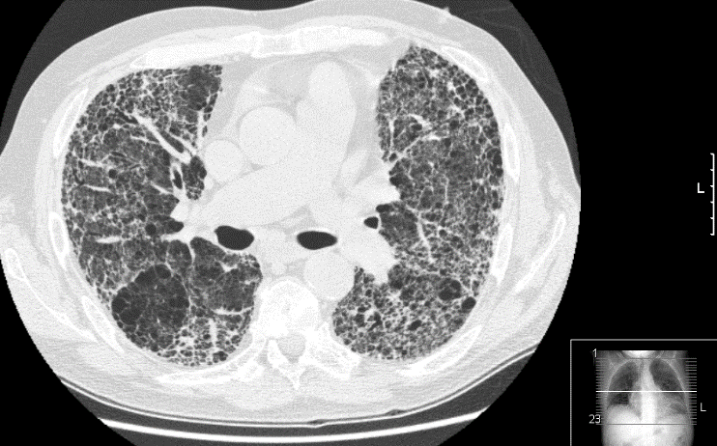


Limitations
The limits of the state-of-the-art applied In our research-
Data finding.
Low resolution.
Fig: Low Resolution Images

Slide 40

Recommendations
Further analysis for more case detection.
Fruitful for Covid-19 Researcher.
Collection of high resolution image.

Slide 41

Thank you!

Slide 42
Thesis Conducted by
Abdullah Al Mamun (ID :160205103)
Nusraat Nawreen (ID:160205091)
Nafe Muhtasim Hye(160205095)
Tahmina Islam(ID:160205092)
Undergraduate Students of
4th year 2nd semester
Dept. of EEE,AUST

